Slide 1

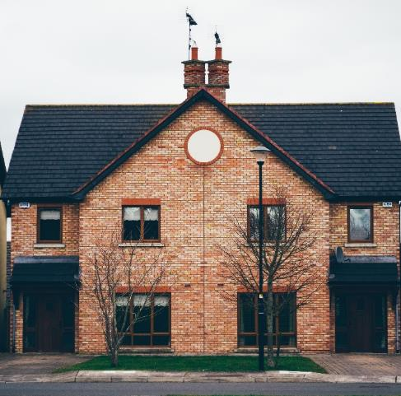
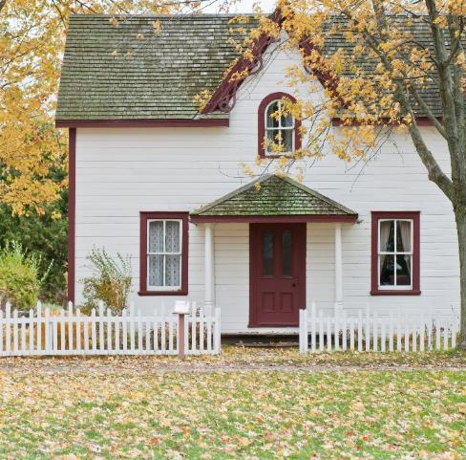

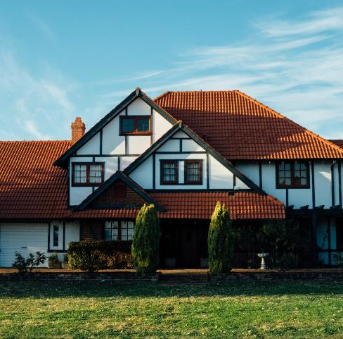
Home Buyer Workshop
03/18/2025
MERRIMACK VALLEY
HOUSING PARTNERSHIP
Notes:
https://unsplash.com/photos/pmhdkgRCbtE
https://unsplash.com/photos/561igiTyvSk
https://unsplash.com/photos/1ddol8rgUH8
https://unsplash.com/photos/bjej8BY1JYQ
https://unsplash.com/photos/XJnP4L958ds

Slide 2

ROLE OF YOUR REAL ESTATE AGENT
AGENCY RELATIONSHIPS
  Buyer Agent
  Seller Agent
  Dual Agent
  Facilitator
YOUR REALTOR IS YOUR GUIDE
  Provides Access to View Properties
  Resource For Information and Guidance
EXCLUSIVE CONTRACT
  Changing Regulations
WHO PAYS YOUR REALTOR’S
COMMISSION?
Notes:
https://unsplash.com/photos/w3eFhqXjkZE

Slide 3
IMPORTANT FIRST STEPS
YOUR GOALS and VISION
  Single Family
  Condominium/Townhouse
  Investment Property (Multi-Family)
YOUR LENDER and LOAN OFFICER
  Native and External Loan Programs
  Explanation Of All Financing Options
  Timely Availability
YOUR PURCHASING POWER
  Pre-Qualification Amount
  Realistic Budget
TWO INVESTMENTS
  Property
  Mortgage

Slide 4

ACCOMPLISHING YOUR GOALS
WITH YOUR AGENT
CONSTANT COMMUNICATION
  Questions and Concerns
  Changes In Goals and Circumstances
KNOW YOUR MARKET
  Understand What Your Money Buys
  Consider Local Market Conditions and Competition
TIME IS OF THE ESSENCE
  Visit Properties As Soon As They Are Available
  Be Decisive But Not Rushed
Notes:
https://unsplash.com/photos/LMq-rTluKfQ

Slide 5
MAKING
AN
OFFER
WHAT IS AN OFFER?
  Contract That Describes Your Intentions
  “Mr./Mrs. Seller, I Offer you….”
  Contingencies
FIRST EARNEST MONEY DEPOSIT
  You Determine The Amount
  Held By Seller or Seller’s Representative
  Buyer’s Remedy For Breach Of Contract
LEAD PAINT INSPECTION
  Property Transfer Notification Certification
  Right To A Lead Paint Inspection
  90 Days After You Own The Property - Strict Liability

Slide 6
Home Inspection
Is A Home Inspection Required?
Your Best Opportinuty To Underdstand The Condition Of The Property You Are Buying
  Realtors Are Not Licensed Inspectors and Cannot Provide Opinion As To Condition
Hire A Licensed Home Inspector
  Opinion Based On What Is Visible
Inspection Report - What Now?
  Seller Makes Repairs Before Closing
  Price Reduction
  Price Reduction And Seller Repairs
  Terminate Transaction and Return Of Deposit

Slide 7
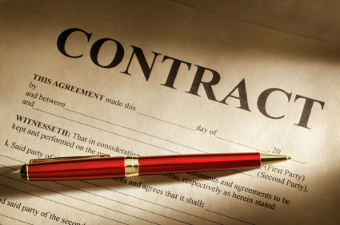
PURCHASE & SALES AGREEMENT
CONTRACT
Conclusion of Negotiations Between Buyer And Seller
Written Agreement To Purchase Property
SEEK LEGAL ADVICE
Review Contract With Your Attorney
SECOND EARNEST MONEY DEPOSIT
Larger Than First Earnest Money Deposit
2% To 3% Of Purchase Price
NOTIFICATION TO CURRENT LANDLORD
Notify Current Landlord Of Your Impending Move
Notes:
https://unsplash.com/photos/yKuDZ23WIYU

Slide 8

Today’s Market
Spring and Summer Markets
Single Family Inventory
Limited Multi-Family Properties
Higher Than Accustomed Interest Rates
Innovative Loan Programs With Buyer Payment Assistance
More Buyers In Spring and Summer
Stronger Buyers
Strong Offers
Notes:
https://unsplash.com/photos/w3eFhqXjkZE

Slide 9
Recommendations
BUYING YOUR HOME NEEDS TO BE A FOCUS
  Home Buying Process Is Different For Everyone
  Allocation Of Time
  Dedication To Financial Objectives
UNDERSTAND ALL ASPECTS OF YOUR JOURNEY
  “Roads with Bridges”
  Your Team Serves As Your Guide
BEGIN LIVING WITH NEW BUDGET
  Home Should Fit Your Lifestyle
  Increased Savings

Slide 10

Hernan B. Guerrero
BLAIREMONT REALTY GROUP, LLC
170 LOWELL STREET
METHUEN MA 01844
Mobile: (978) 804-2505

