Slide 1

Home Inspections for First Time Buyers Michele James

Slide 2



Who am I?
Managing Partner of RJ Inspections
2nd Generation Home inspector and Contractor
Licensed inspector in MA and NH
Licensed Contractor
Licensed pest professional
10+ yrs inspection experience
Certified to teach CE Classes for NH

Slide 3

Who am I??
Licensed Home Inspector
MA and NH
Licensed Contractor
Performed ~1,000 inspections, 3+ years
Mold specialist
InterNACHI CPI
Certified Professional Inspector

Slide 4

A Home Inspection IS….
A general, visual inspection of readily accessible and observable areas
A“snapshot in time of the condition of a home”
A general inspection of the major systems and components of a home, quite like a medical examination by a general practitioner or MD
Must conform to the standards of practice required by the board of registration of home inspectors.

Slide 5

A Home Inspection is NOT….
Per the standards of practice
A comprehensive Architectural and/or Engineering study
Technically exhaustive
A Pass Fail test
For Insurance
It does not eliminate all the risk in home ownership
Overly Intrusive to the home
We are guests in the home
A code inspection
A prediction of the future

Slide 6
Inspector is PROHIBITED from…
Reporting on the market value of property or its marketability and/or the suitability of the property for any use.
Advising their Client about the advisability of the purchase of the property.
Determining the cost of repairs of any item noted in their Report
Offering to make and/or perform any repair, provide any remedy
Operating any system or component that is shut down or otherwise inoperable.
Turn on any electrical or fuel supply and/or devices that are shut down.

Slide 7
Qualifications of a home inspector
Massachusetts
75 classroom hours + Pass national Exam +25 Observed inspections = Associates licensed
1 yr with associates + 100 inspections = Full license
New Hampshire
80 hours in classroom/online + Pass national exam = Full license
Maine
No licensed required (Does require a Radon License)

Slide 8
Tips for finding a home inspector
Per the MA Facts sheet…..
A home inspector's license should be verified prior to hiring.
The home inspection company that is retained should welcome the potential buyer's presence at the home inspection.
The home inspector should be willing to address all of the buyer's questions and provide a full verbal and written report.
Those hiring an inspector should expect an open door policy from the home inspection company to be able to ask questions about the content of the home inspection report in the future.

Slide 9

Selecting a Home Inspector
Reviews
Google, Yelp, Etc.
Personal Referrals
friends, neighbors, or business acquaintances who have been satisfied with a home inspector
Lawyers and mortgage brokers
Real estate agents may not directly recommend a specific home inspection company or home inspector unless representing the buyer as a buyer's broker

Slide 10
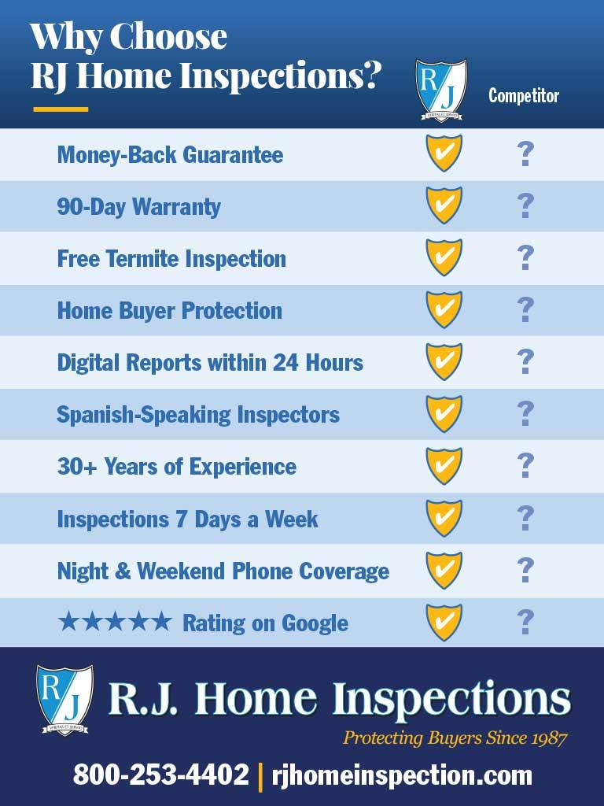
Compare….

Slide 11
Inspection Reports
The State Standards of Practice dictates..
What to “Observe and Report on”
What to “Identify”
What the inspector “Shall” and “Shall not”…
Sets exclusions
Sample….
Refer to rjhomeinspection.com

Slide 12
New Home Inspection Law
Passed as of Oct 15th 2024
No longer able to waive home inspection prior to being under agreement
Not required to get home inspection
Seller must allow buyer the right to an inspection
Can still negotiate inspection terms prior to agreement
Aggregate for negotiations
Deposit Refund
Contingency time frame

Slide 13
Why Should A Buyer Get A Home Inspection?
You get an education, not just an inspection
Ask any questions – during and after inspection (BE THERE!! –Better visual)
Get a good feel for the house
Help you in your decision making (Objective view of the home)
Gain an edge in negotiating
Move into home with detailed knowledge of the condition
Buyer is the client of the inspector – confidential independent 3rd party
Inspector works for YOU!

Slide 14
Average Replacement Costs
Roof – $10-30k
Windows – $15k ($750 per window x 20)
Siding – $15-30k
Heating replacement – $10k-30K
Central AC – $7-15k
Foundation repair – $5,000+
Termite treatment - $2,500
Mold in Attic – $4,000+
Vermiculite – $5,000+

Slide 15
What is covered on an inspection
Roofs
Exterior
Structure
Interior
Attic
Bathrooms
Kitchens
Plumbing
Heating/cooling
Electric
***Wood destroying insects***
NOT ALWAYS INCLUDED

Slide 16
Be Prepared…
Arrange Schedule to be present
No perfect house!
We ALWAYS find things even new homes
Make sure all utilities are on
Bring up any known concerns at start of inspection
Don’t wait to book! Contingency windows close fast and good home inspectors’ schedules fill up

Slide 17
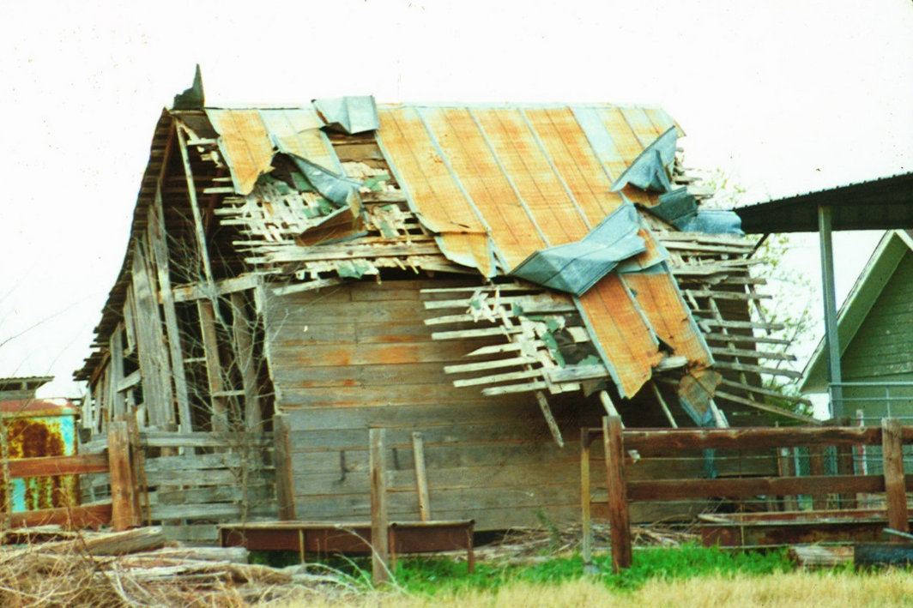
The Home Inspection Process
99% of Everything is Repairable!!

Slide 18
Roofs
Is the roof beyond its expected life?
Asphalt shingles = 3 tab 20 yrs, Architectural 30+
Rubber roof = ~30 yrs
Rolled roofing = 10-15 yrs
Slate = 50+ yrs (requires maintanence)
Metal = 30-100 yrs (requires painting)
Coverings
Ventilation
Flashings
Skylights
Chimneys
Drainage/Gutters
Any Roof Penetration

Slide 19
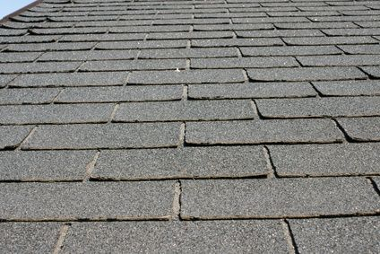
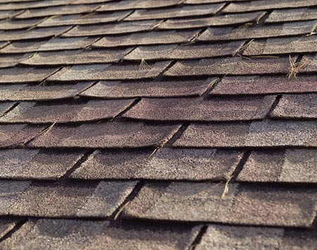
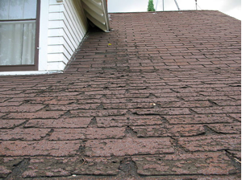
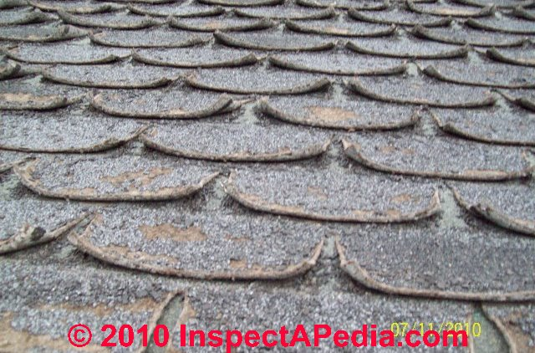
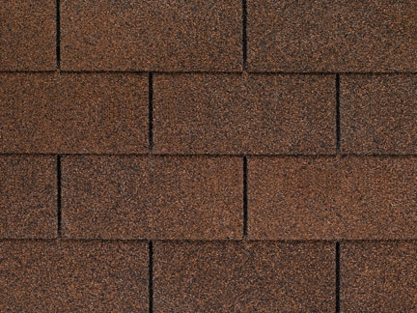
Roof examples…

Slide 20

Exterior & Grounds
Siding/Walls
Trim/Fascia/Soffit/Flashing
Veneer
Doors
Windows
Plumbing fixtures
Electric Service
Drainage
Vegetation
Steps/Walkways
Decks/Porches
Driveways
Retaining walls
Patios
Grading

Slide 21
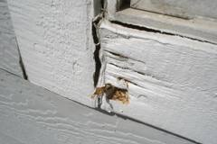
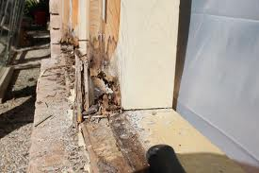
Trim and Siding
Damage?
Rotted trim or siding?
Rotted trim/siding can cause secondary damage!

Slide 22

Interior
Walls/Ceilings/Floors
Doors
Countertops
Sinks/Wet bars
Fireplaces
Stairways & Railings
Water Intrusion

Slide 23
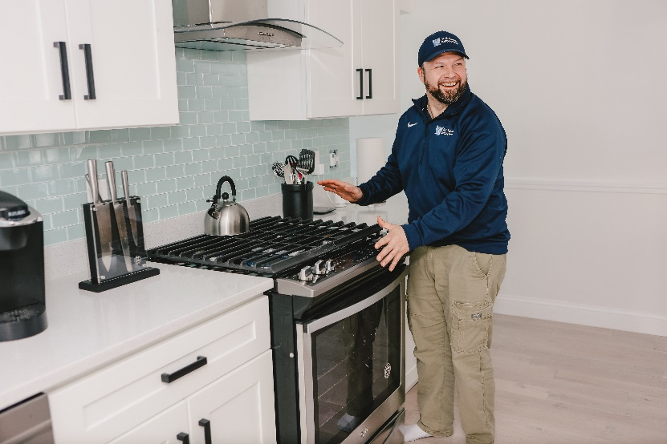
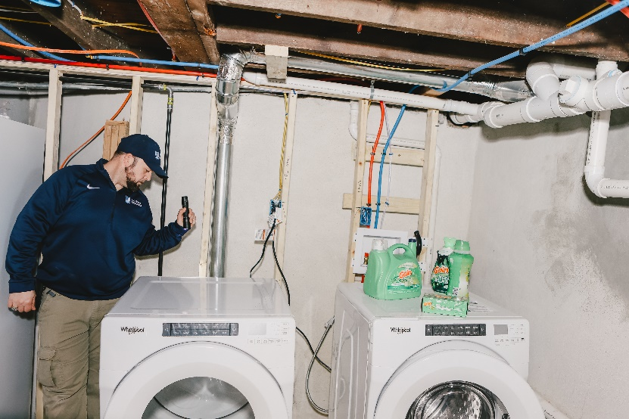
Kitchens & Laundry
Sinks/Faucets
Counters/Cabinets
Garbage Disposal
Dishwasher
Exhaust Fans
Stove/Oven
Dryer Vents/Service
Washer Hookups

Slide 24
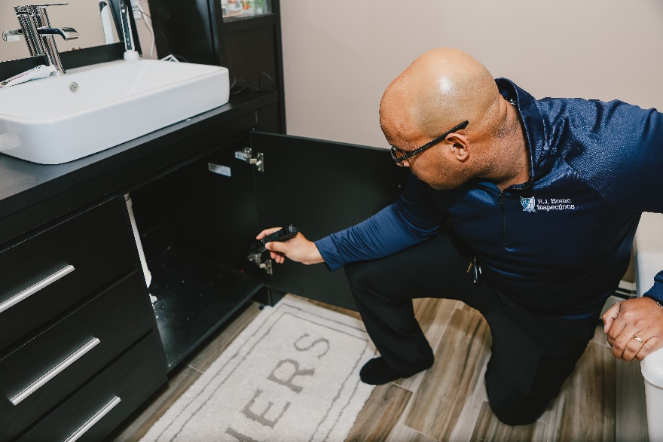
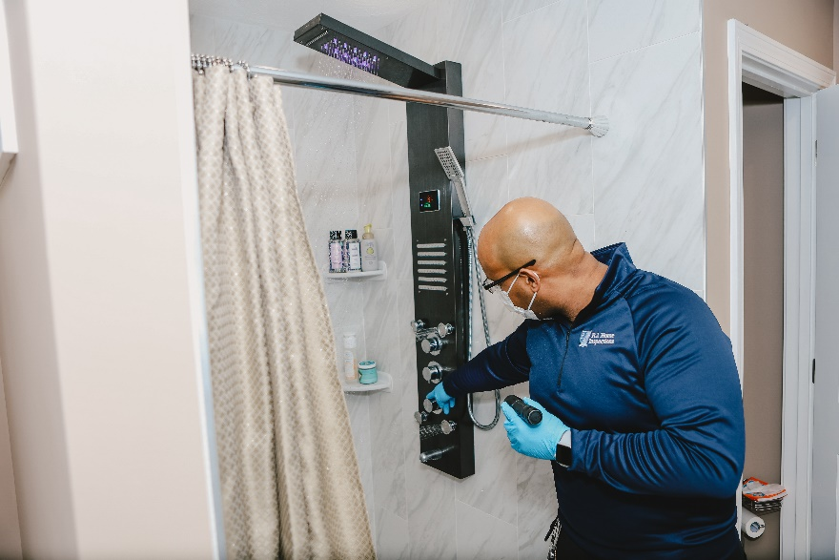
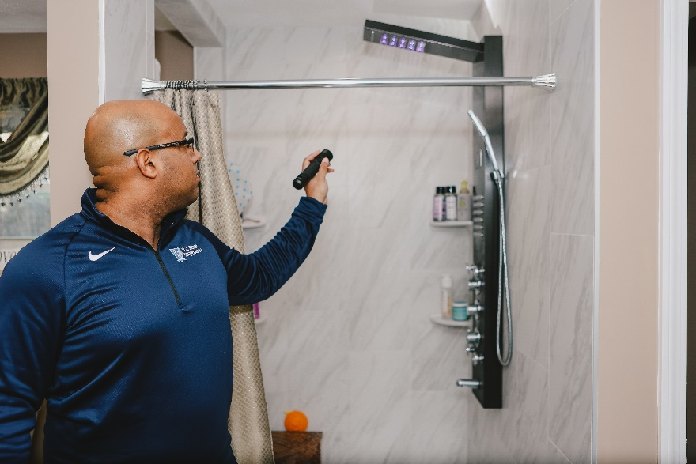
Bathrooms
Exhaust vents
Sinks/Faucets
Toilets
Showers
Tubs
Jet tubs

Slide 25
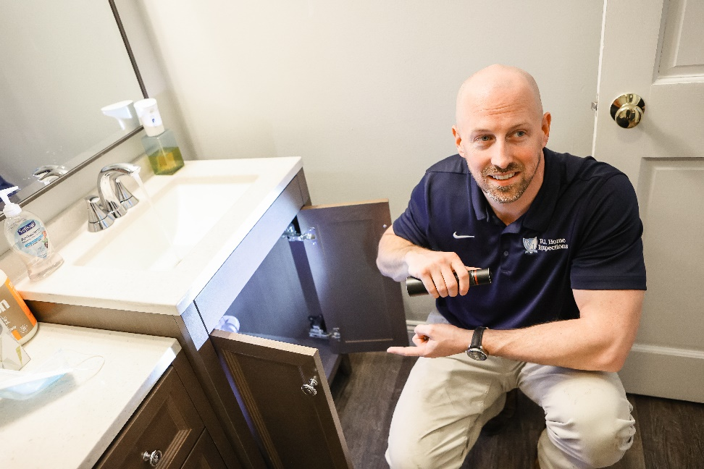
Plumbing
Main Supply Pipes
Main drains
Shut-off Valve
Faucets
Fixtures
Plumbing Line Leakage or Corrosion
Water Pressure
Water Heater
Interior Well Components
If applicable

Slide 26
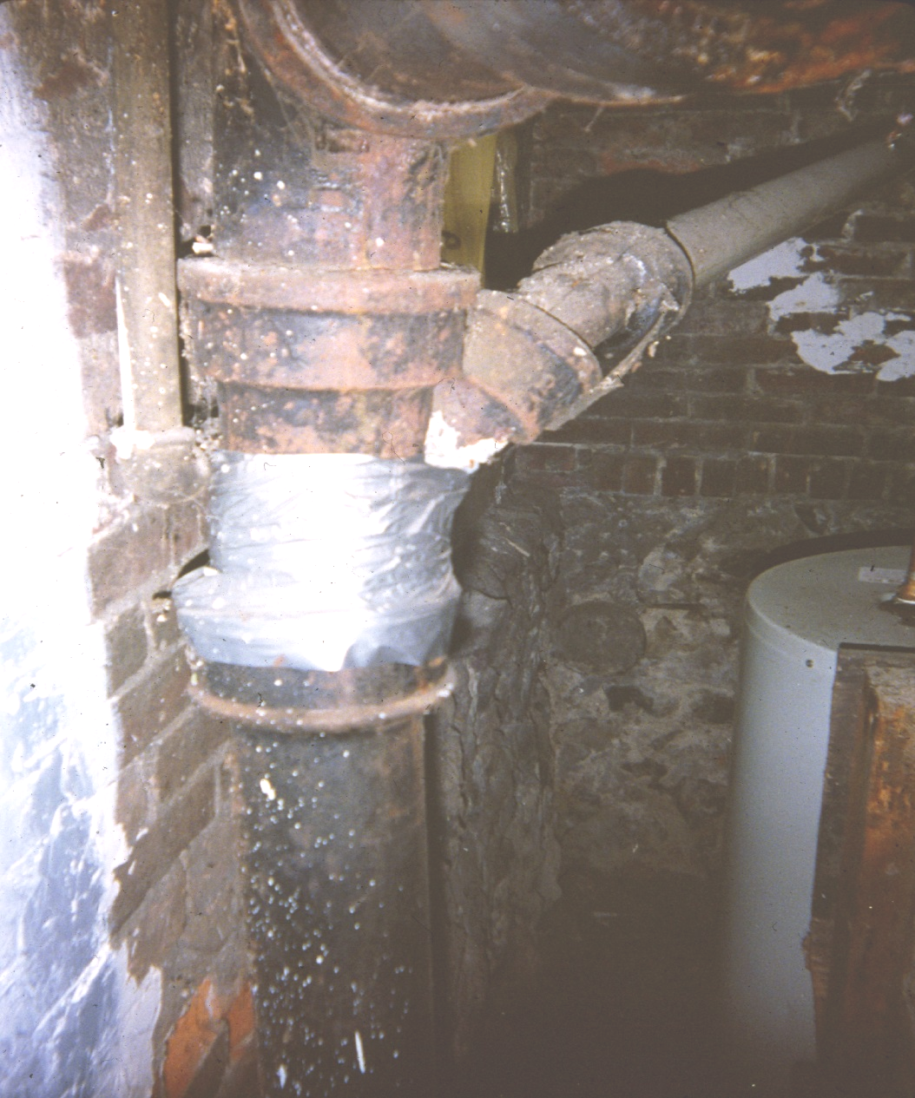
Plumbing

Slide 27
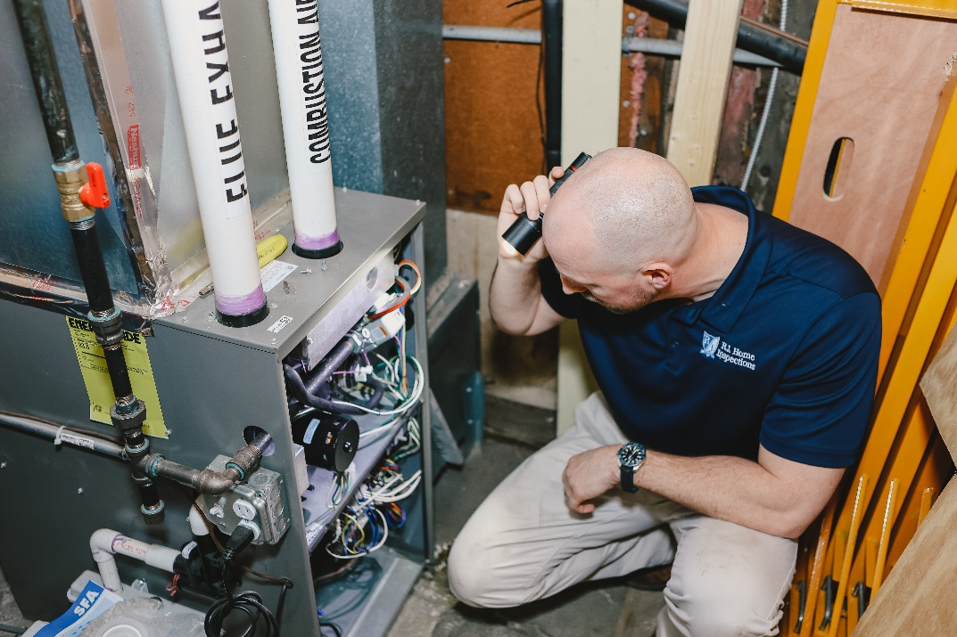
Heating & Cooling
Cooling Function
Heat Function
Exhausts
Burners
Insulation
Distribution
Thermostats/controls
Oil Tanks & Lines
Air Filters

Slide 28
Heating/Cooling Systems
Identify the heat source (hot water, hot air, Etc.)
Is the heat supply beyond its expected life?
Hot water boiler = 30 yrs
Steam boiler = 30 yrs
Forced air furnace = 15-20 yrs
Central Air = 15-20 yrs
Heat pump = 15-20 yrs

Slide 29
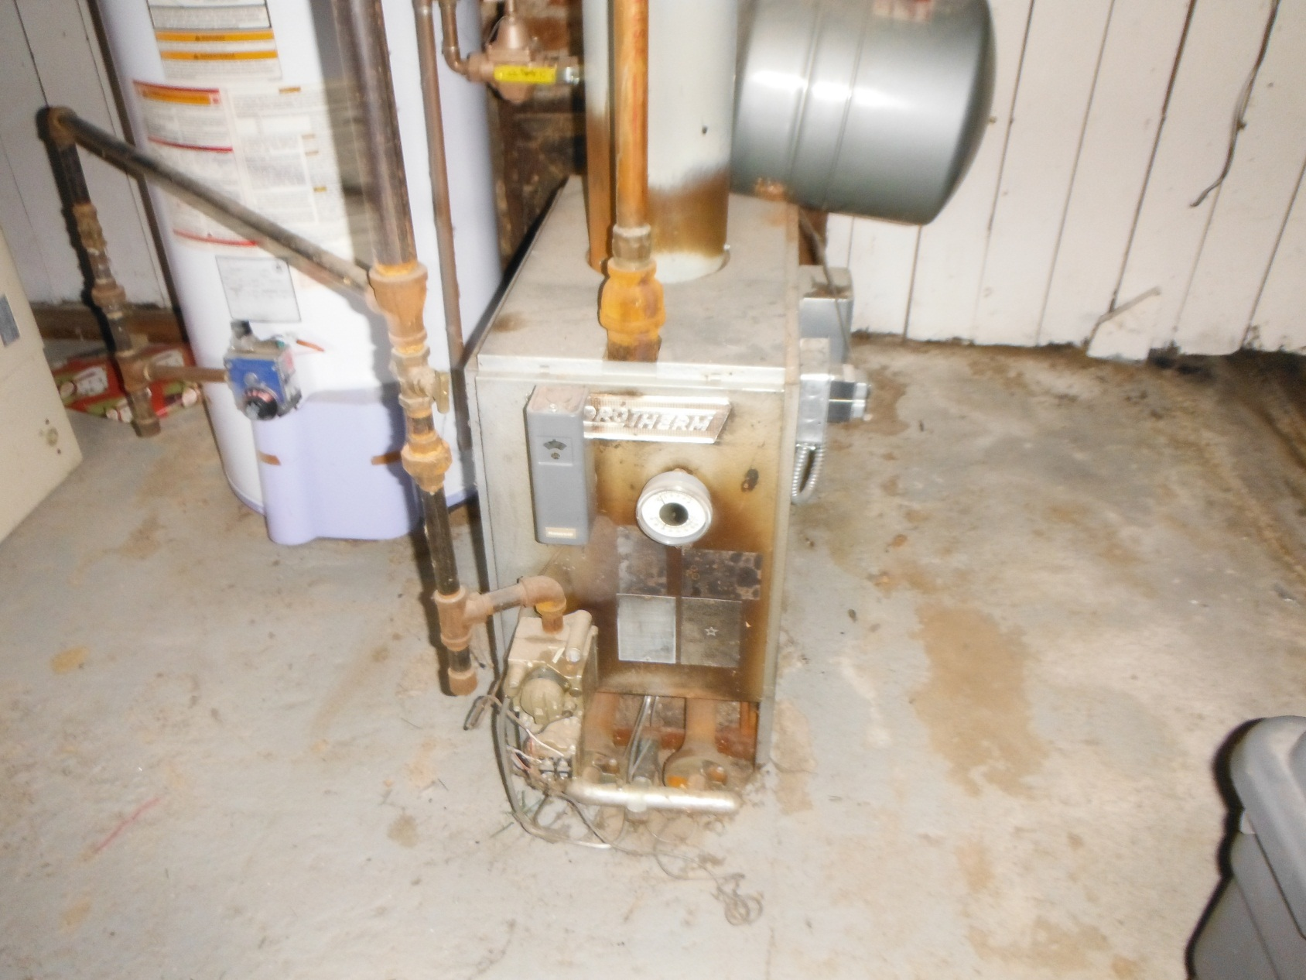
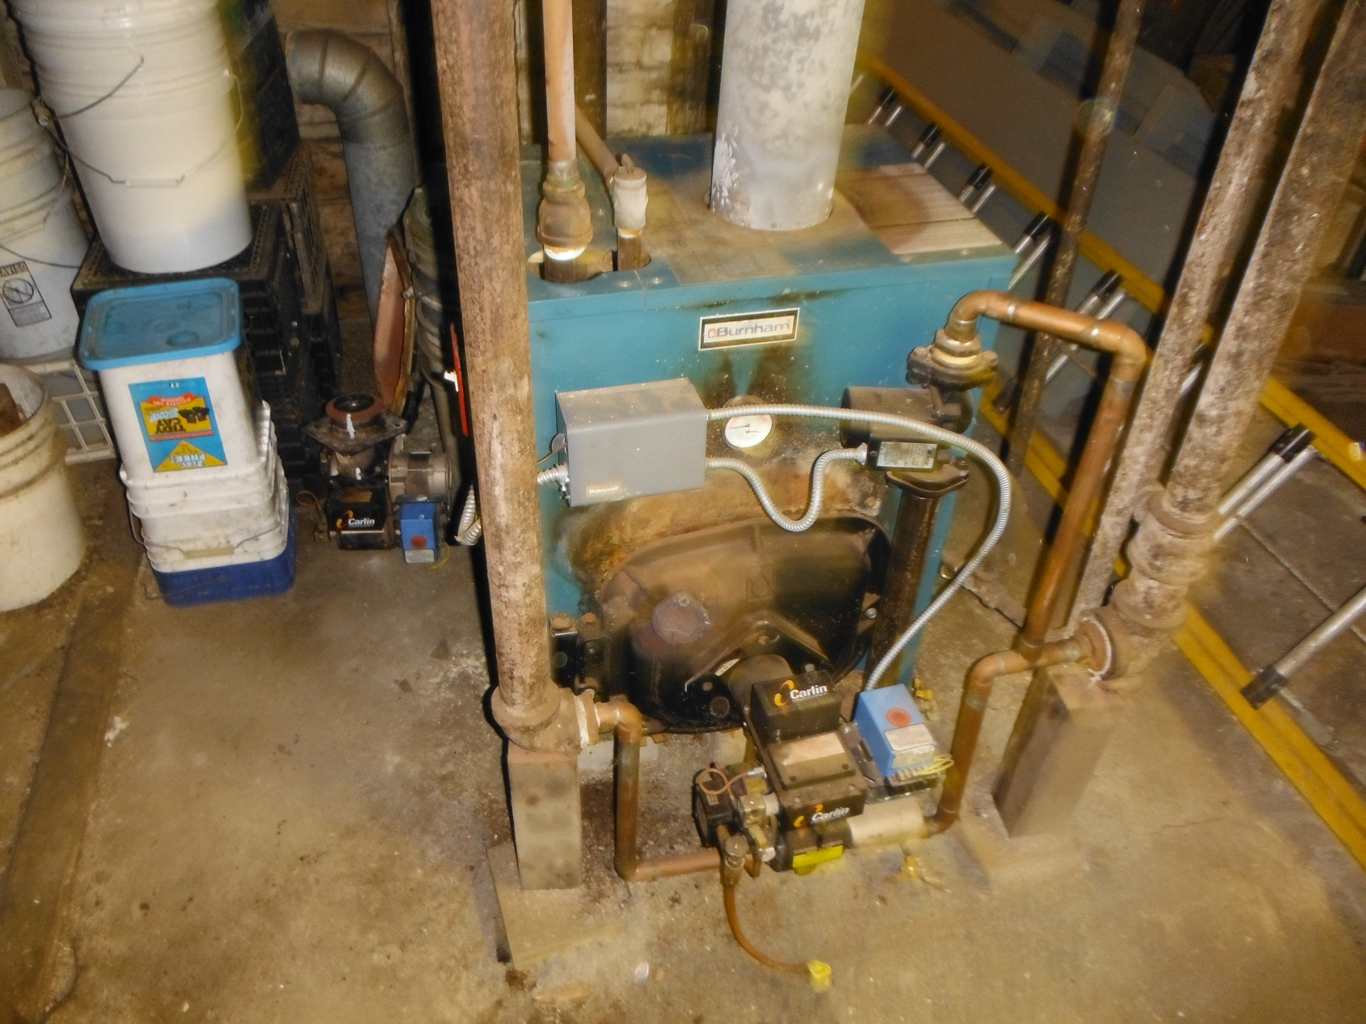
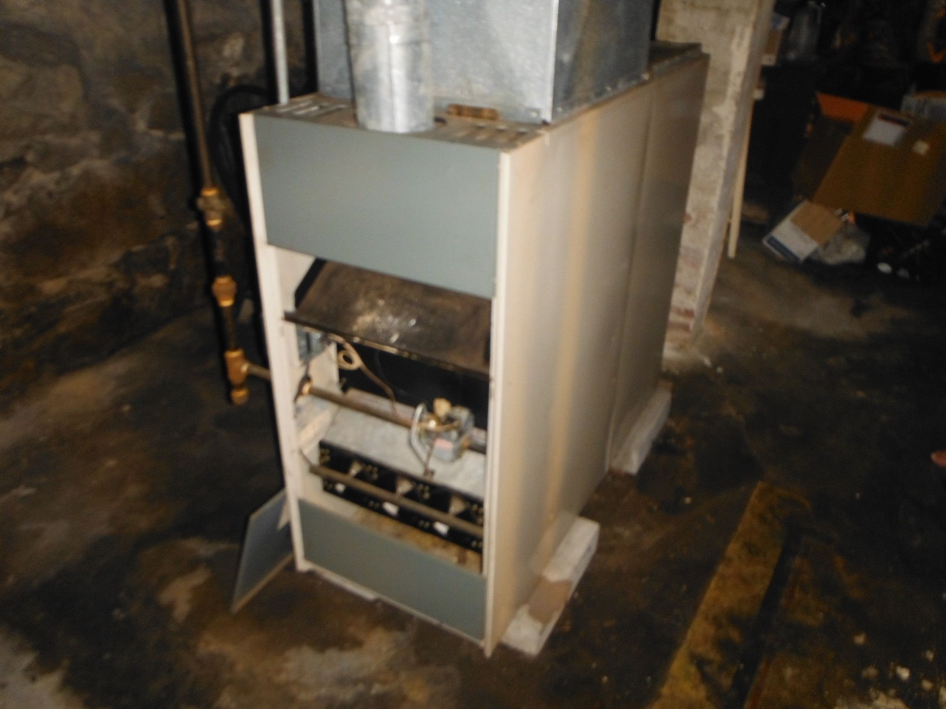
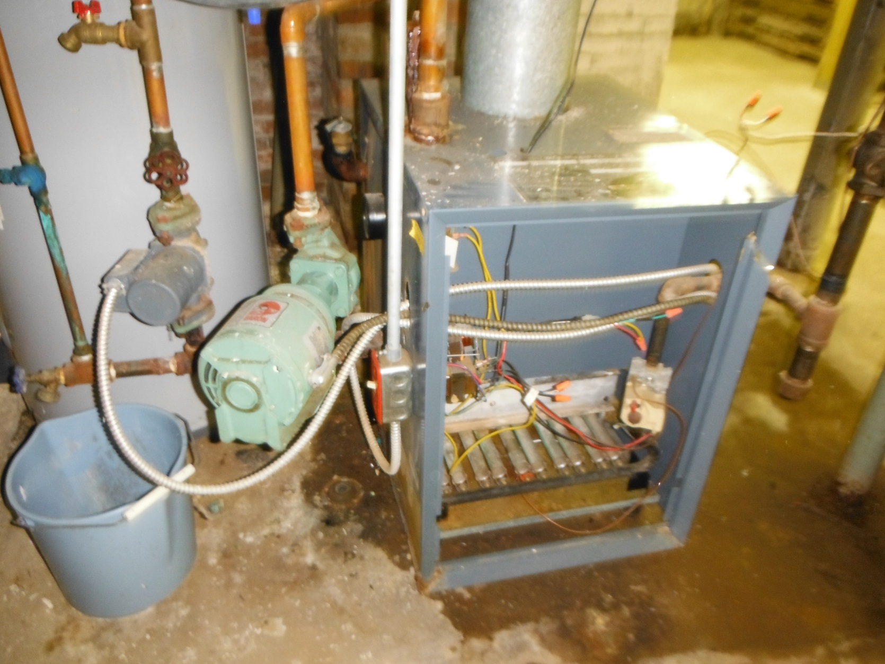
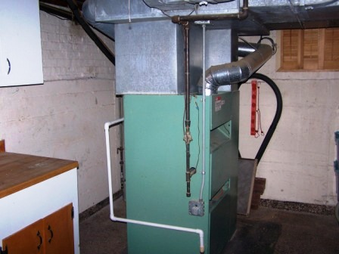
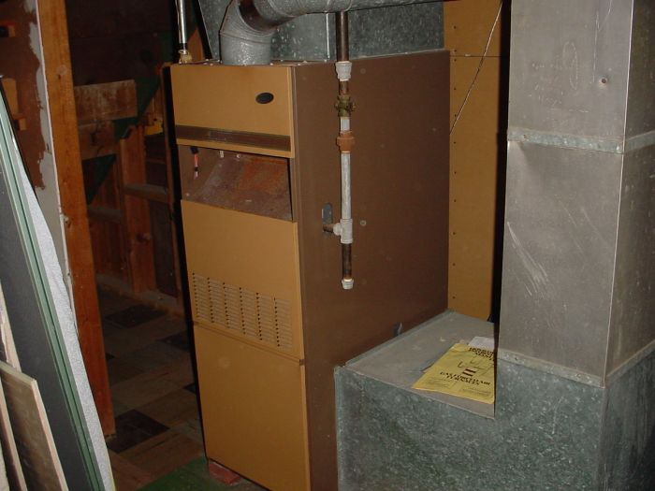
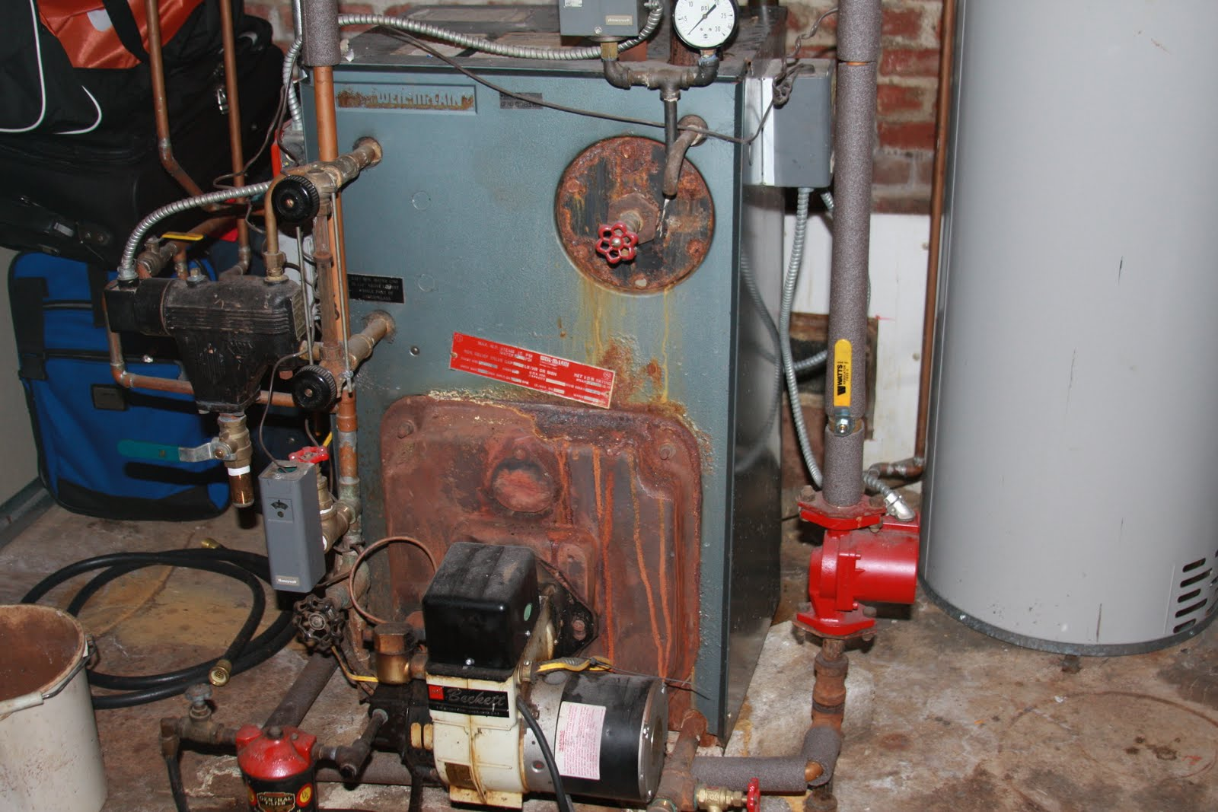
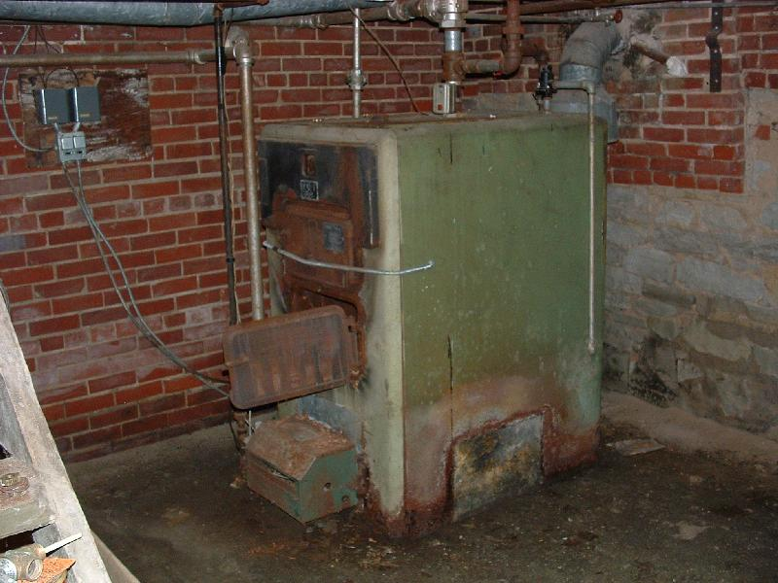
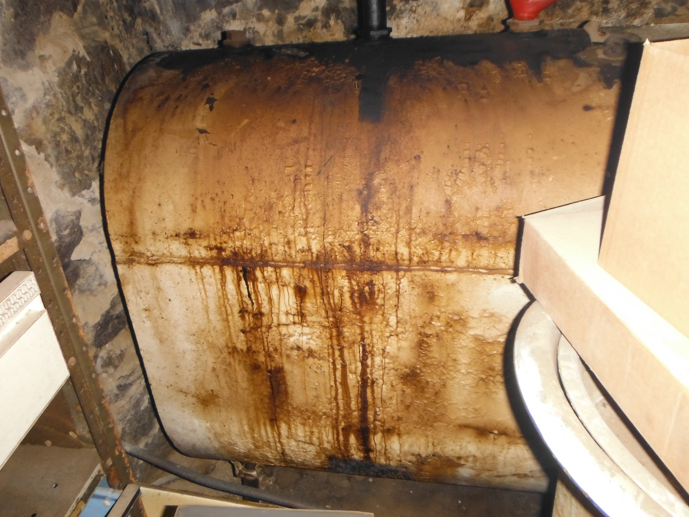
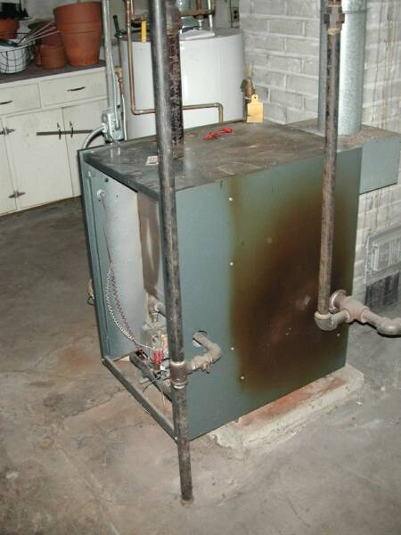
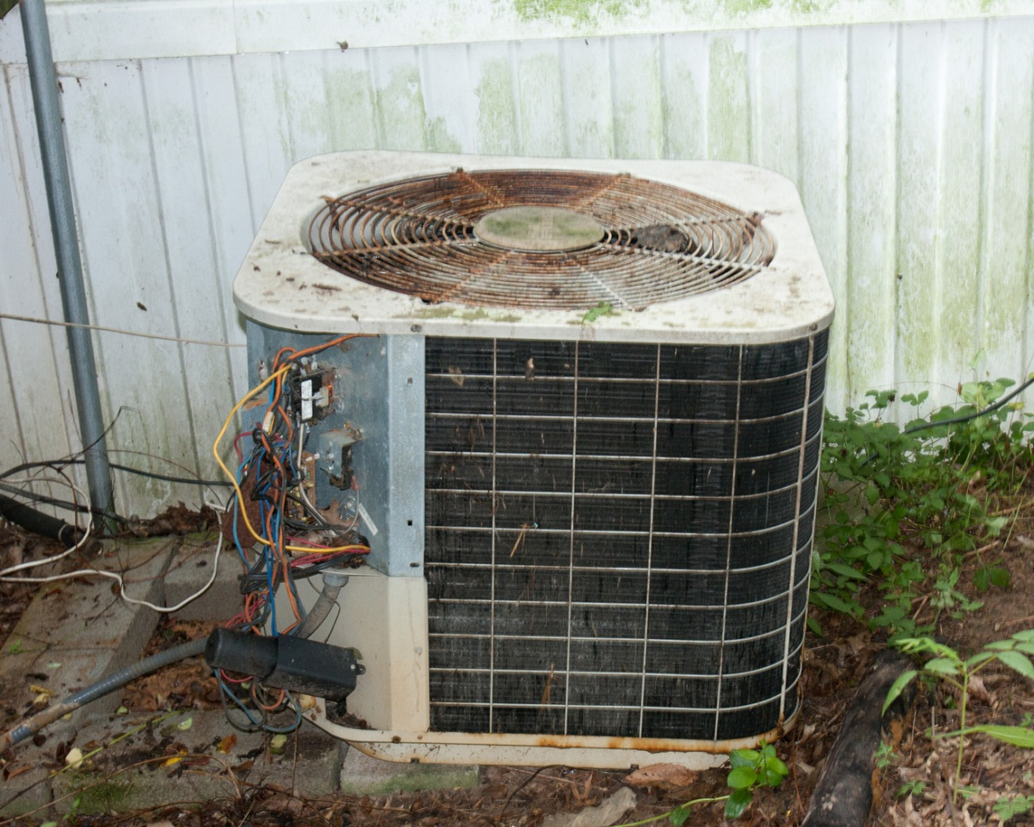
Heating/Cooling examples…

Slide 30
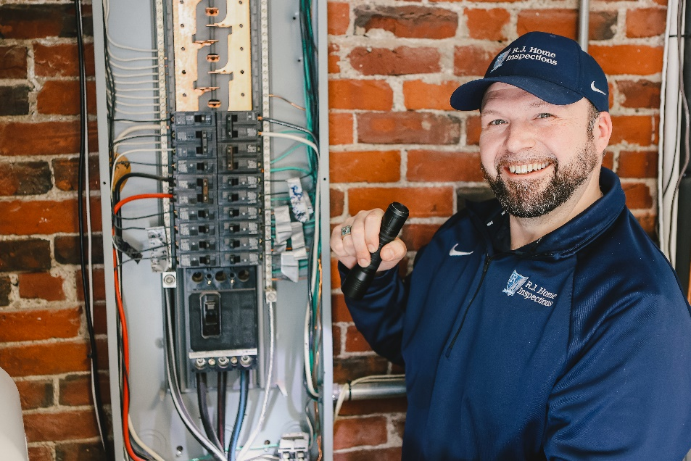
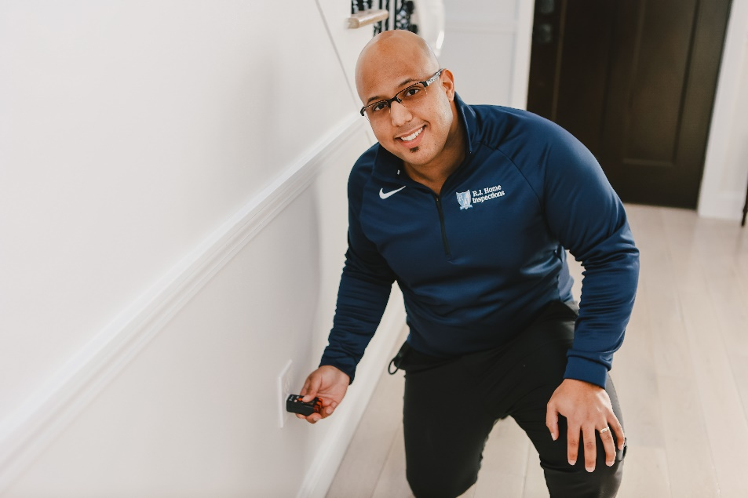
Electrical
Panels & Breakers/Fuses
Corrosion in panels
Grounding
GFCI
Service & Amperage
Wiring
Receptacles and Switches
Fixtures & Lighting
SAFETY

Slide 31
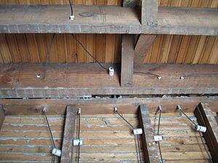
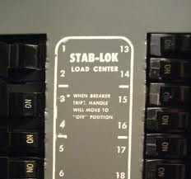
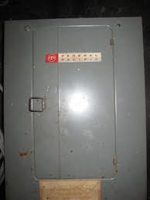
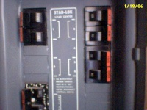
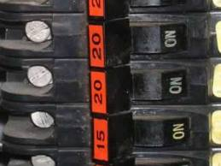
Electrical examples…

Slide 32
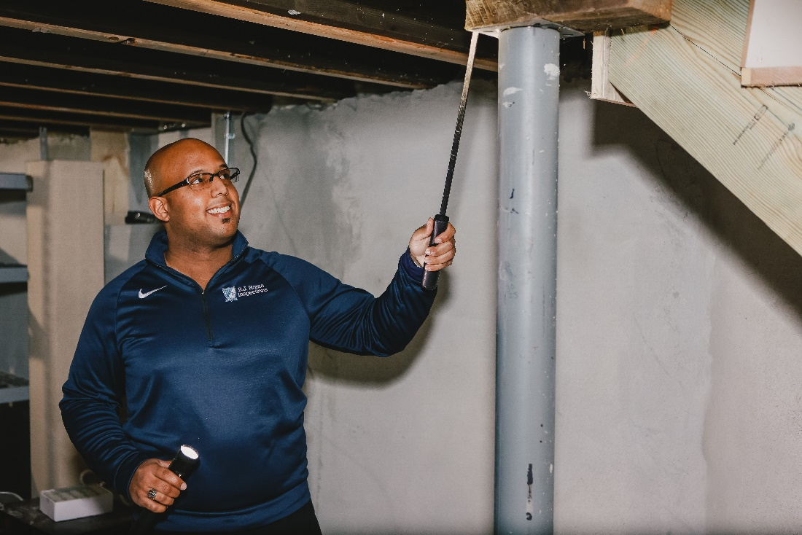
Structure & Foundation
Walls
Framing/Beams
Floors
Sills
Support Columns
Water Seepage
Insulation
Ventilation
Sump pumps
Chimney

Slide 33
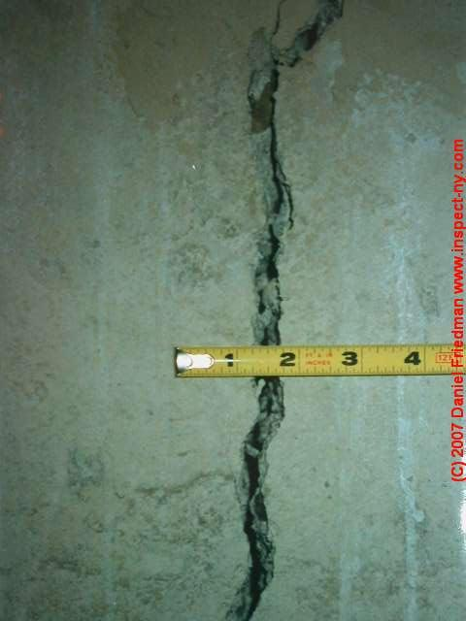
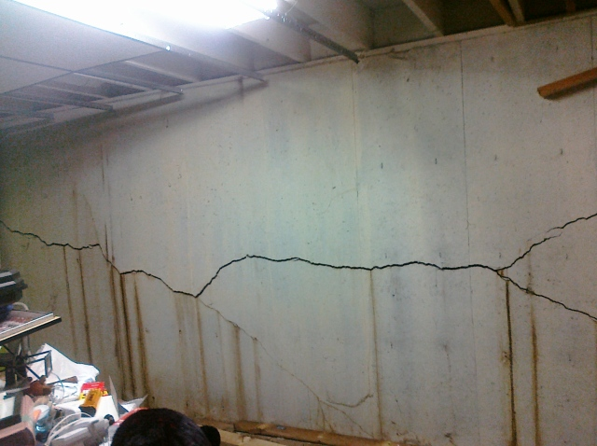
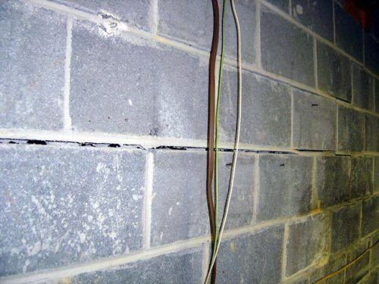
Foundation cracks…

Slide 34
Foundation Issues in CT & Southern MA
Any house built from 1983-present
Can take 5-50 yrs to present problem
Moisture + pyrrhotite causes iron sulfide
Deteriorates concrete
ALL areas of CT
Must have certified foundation specialist evaluate
If not, they waive all rights to CFSIC
Conn Foundation Solutions Indemnity Company
Auto funded by homeowners policies
Southern & Western MA (south of 90 west of 495)
Now found in Worcester area

Slide 35
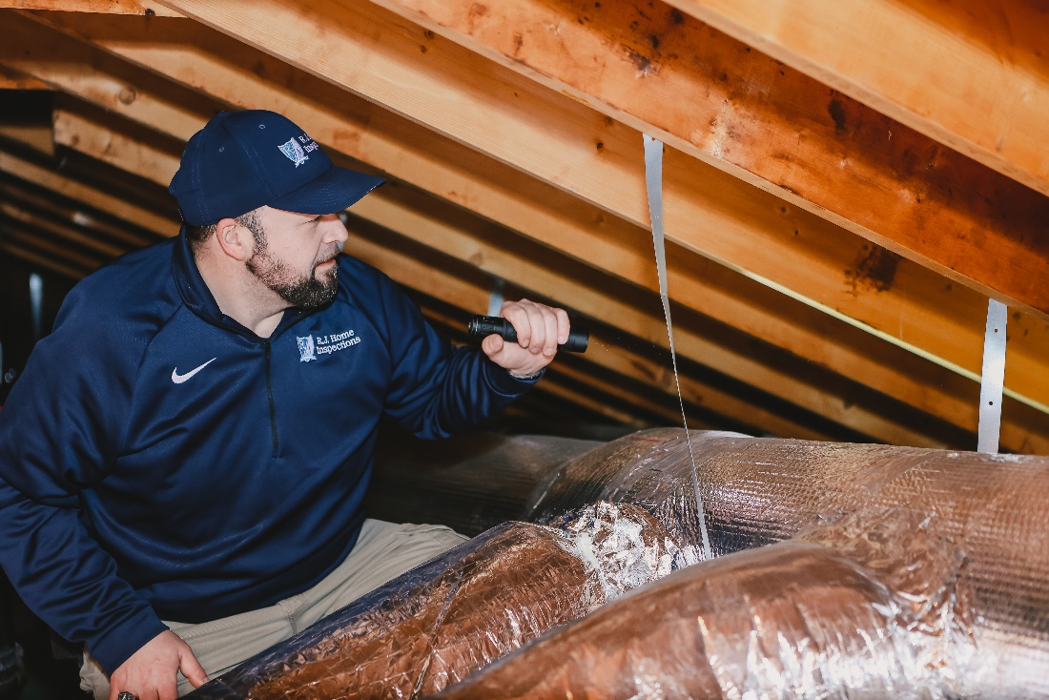
Attics
Structure
Trusses, rafters, etc.
Insulation
Vermiculite?
Ventilation
Sheathing
Water penetration
Chimneys

Slide 36
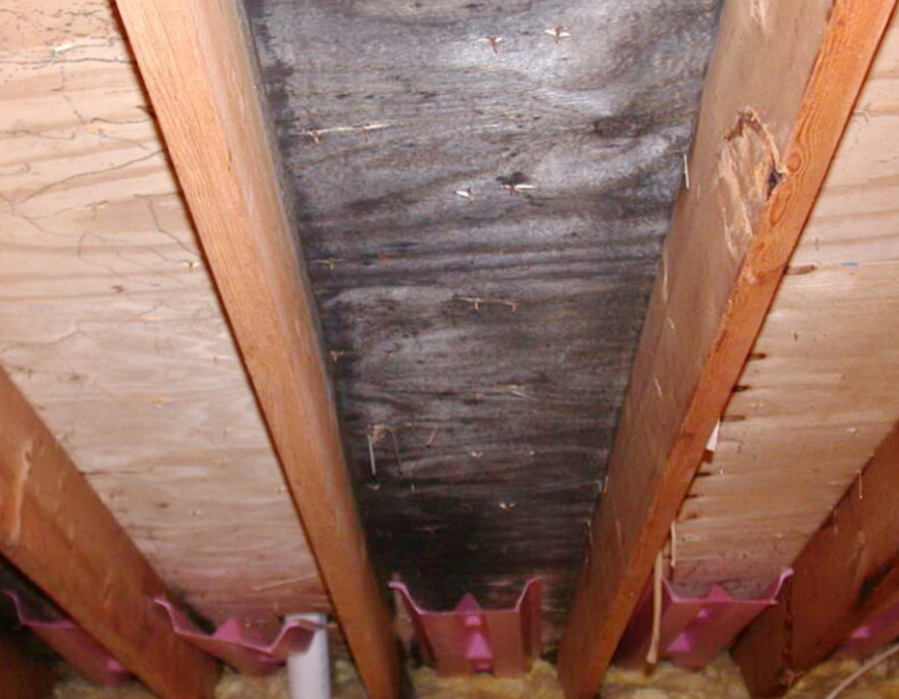
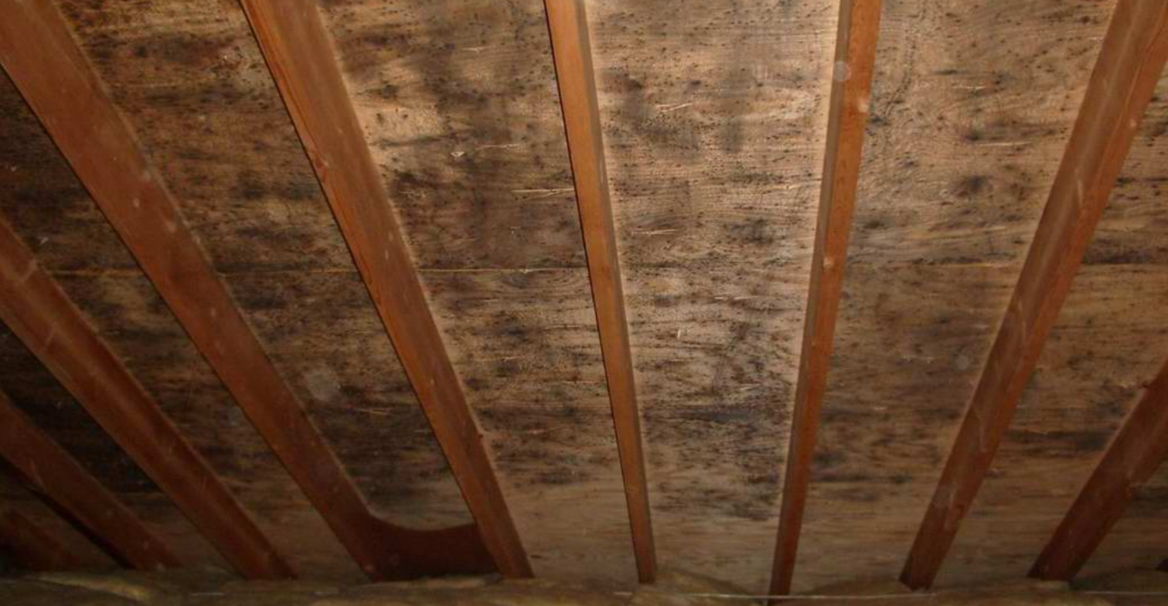
Attic
Blackness on sheathing?
Black spots?
Potential MOLD!

Slide 37
Additional Tests & Inspections
Wood destroying insects
Included with home inspection?
Mold Testing
Indoor air quality
Water quality testing
Is house on a well? VA/FHA loan?
Sewer scopes
RADON
Radon is responsible for about 21,000 lung cancer deaths a year

Slide 38
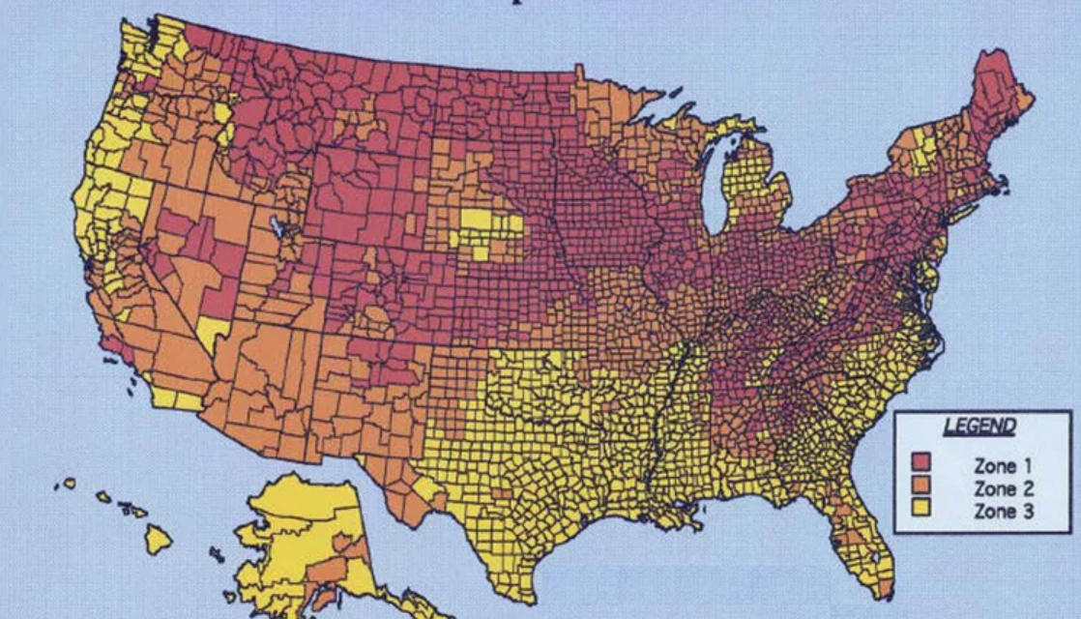

Slide 39

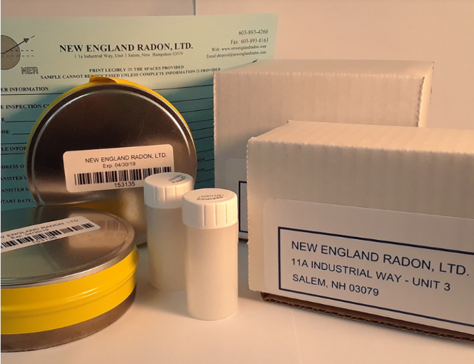
Radon Testing
Electronic Continuous Monitor
Charcoal Cannister or Vials
Hourly radon readings along with average
Measure's temp, pressure, humidity
Motion sensors to affirm no tempering
Instant Results
Always picked up by inspector
Gives average of radon level
Measures Radon Only
Unknown movement of test
Brought to a lab and processed
Picked up by client, inspector, or realtor

Slide 40

THANK YOU!!!!!
Questions???

