Slide 1


Property Insurance Guide
A guide to properly covering your Home from the unexpected
Presented By:

Slide 2

What is Property Insurance?
Risk Management
Protection against financial loss
Takes the risk of having to fully cover your property for it full cost and transfers it to an insurance company in exchange for a premium.

Slide 3

Is all property Insurance the same?
Renters Insurance
Home Owners Insurance (H03)
Condo Insurance (H06)
Master Policy
DP-3 – LandLord
Non-owner occupied
Vacant
Home Under Construction / Reno

Slide 4
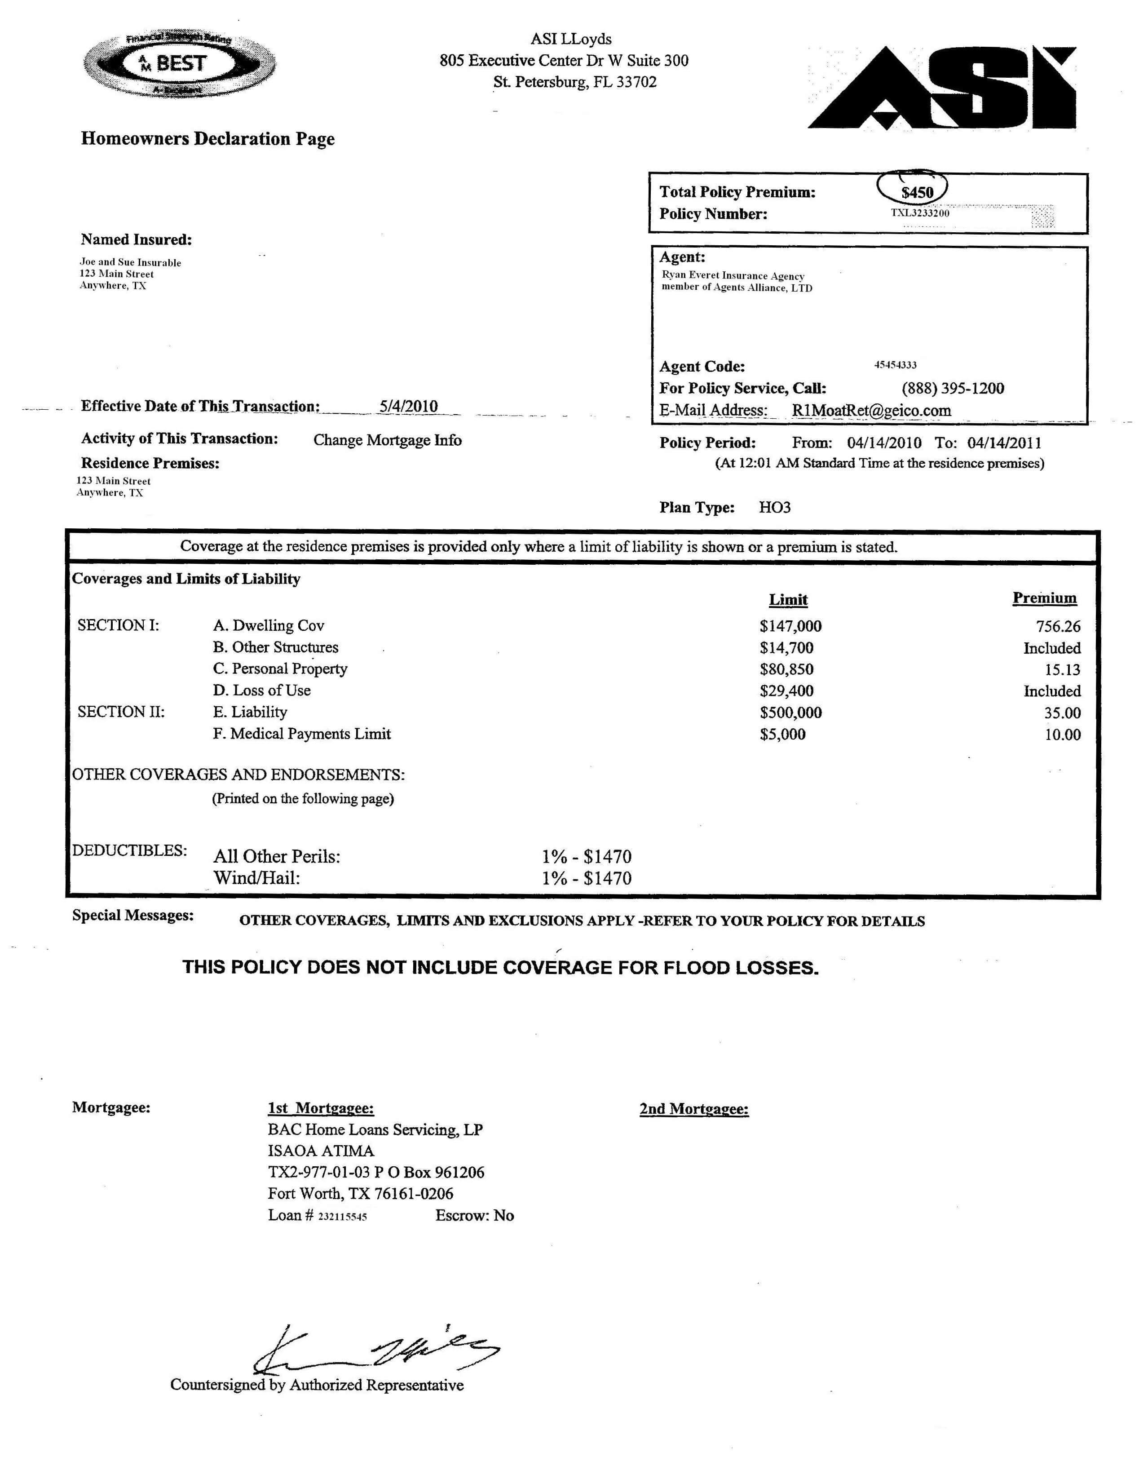
What Are Policy Limits:
How much your Insurance company can cover you for.
Coverage Types
Dwelling
Other Structures (sheds, garages, pools, fences)
Personal Property (clothes, furniture, jewelry)
Loss of Use
Personal Liability
Medical Payments to Others
Deductibles
What's events are typically covered?
What events are not covered?

Slide 5
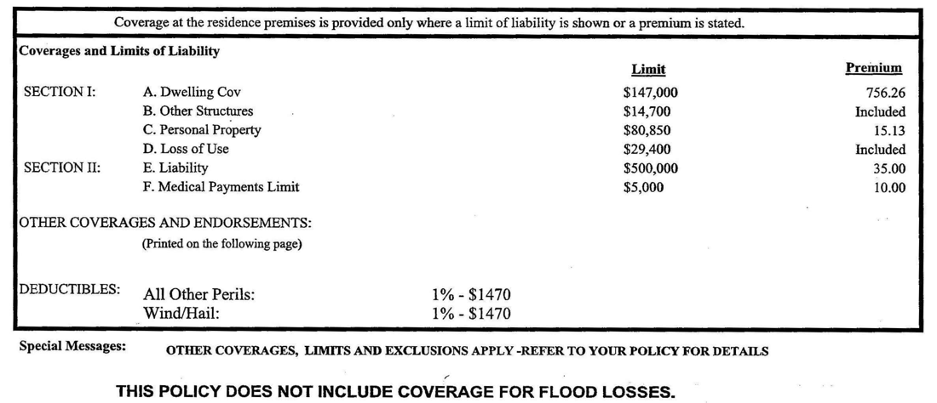

Slide 6


Things to consider:
A full Insurance Review
Auto/ Home/ Life – MTG Protection
Exclusions – What is not covered
when to contact your insurance company
Home insurance is a Live Document
It grows with you
Annual or Bi- annual Policy reviews

Slide 7
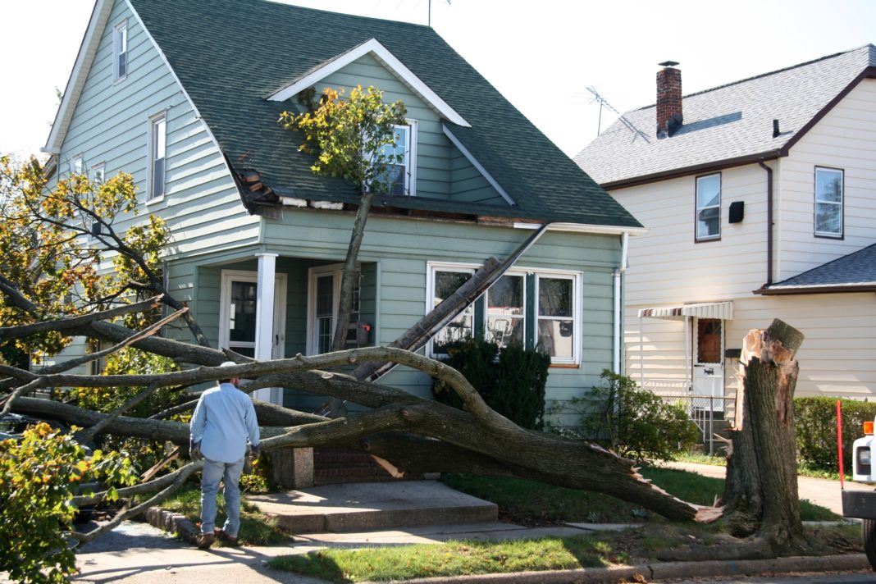
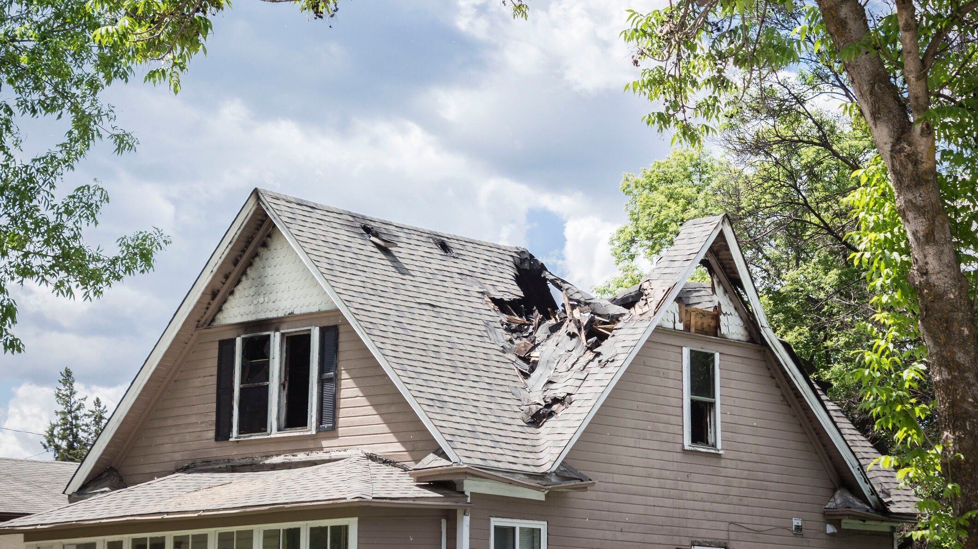
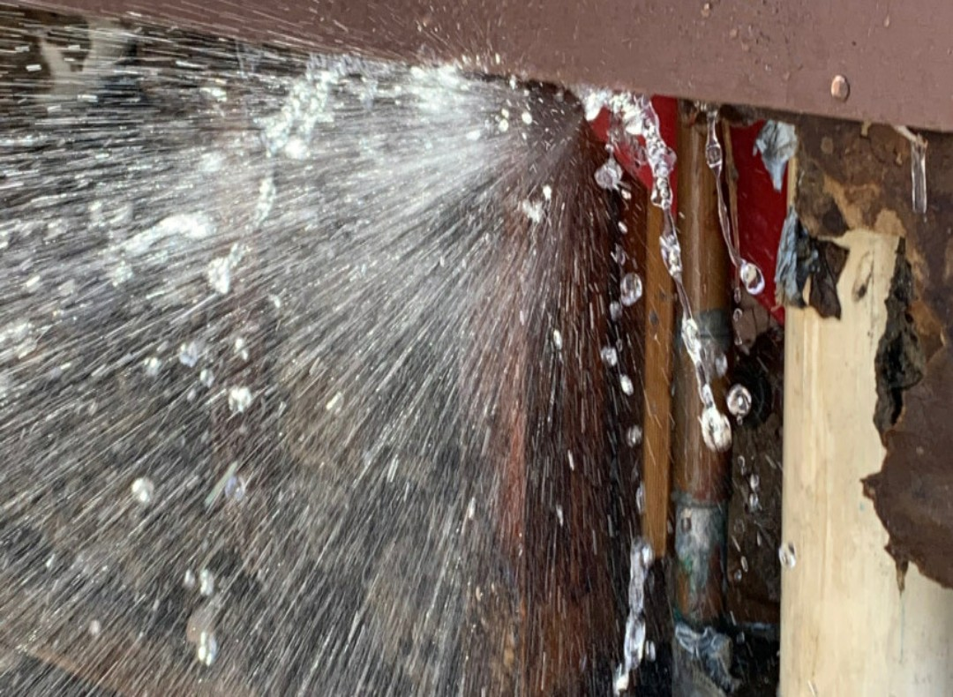
Claims
Filing Claims:
Reach out to your agent
Can the claim be filed?
Is the claims worth filing ?
What happens During the claims Process?
What happens after?

Slide 8

Use An Agent You Can Rely On
Jerry Etienne Agency President Armored Insurance Phone(Call/Text): 781-305-0201 Fax: 978-219-0186 Email: Jerry.Etienne@InsureitWithJerry.com HQ: Haverhill Ma 01876

