Slide 1

Home Buying
Edwin A Restrepo
Community Mortgage Loan Officer
TD Bank Financial Education

Slide 2

What to Expect and Objectives
Learning Objectives
Examine the financial benefits and realities of buying a home
Identify and discuss your biggest questions about home buying
Consider how your credit score impacts home buying opportunities
Evaluate the cost of purchasing a home
Explore the steps of the loan process and compare common loan options
Discover tips to maintain your home and avoid foreclosure
Discuss next steps and resources to learn more

Slide 3
What to Expect and Objectives
Frequently Asked Questions
Am I ready to purchase a home?
How much can I afford? How much does this all really cost?
How much do I need to have in savings for a down payment and other upfront costs?
What credit score do I need to buy a home? How does this all work?
What are the steps in the home buying process? Where do I start?
How long does it take to buy a home?
How can I be sure I’m getting the best loan possible?
I’m getting a mortgage loan, and I heard the term ___ (example: TRID)? What does that term mean?
What if I disagree with the home's appraised value?
Who can I ask for help? Where can I find more information?

Slide 4

Identify Your Why
Goal Setting
What is your biggest question about buying a home?

Slide 5

Thinking about Home Ownership
Rent vs. Buy
What are some benefits
of buying a home

Slide 6
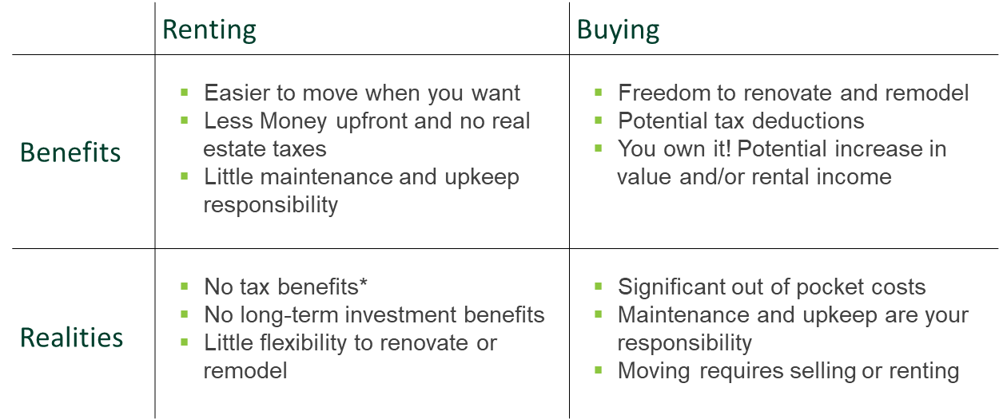
Think About Home Ownership – Rent vs. Buy
*Disclosure. TD Bank does not provide tax advice, and you should consult your tax advisor regarding your individual tax situation.

Slide 7
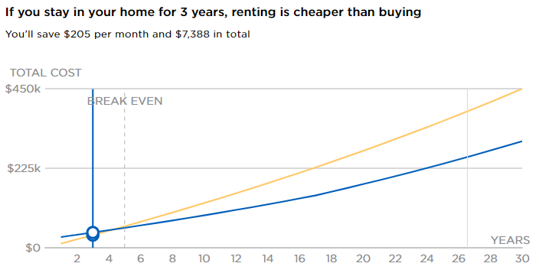
Is it better to rent or buy?
https://www.nerdwallet.com/mortgages/rent-vs-buy-calculator
This in-depth tool compares the overall costs of renting vs. buying to help you make an informed decision.
Access the calculator at

Slide 8
Before you buy: Credit Readiness
Have you checked your credit report?
Simple ways to access your credit report
Visit www.annualcreditreport.com or call 1-877-322-8228 to request a FREE copy of your report annually.
Equifax – www.equifax.com or 1-800-997-2493
Experian – https://www.experian.com/ or 1-888-397-3742
Trans Union – www.transunion.com or 1-800-888-4213

Slide 9
Before You Buy: Credit Readiness
Review your credit report
Download the checklist at
http://www.consumerfinance.gov/documents/2233/ 201701_cfpb_Credit-report-review-checklist.pdf
This step-by-step checklist walks through reading a credit report, watching for mistakes and how to dispute inaccuracies.

Slide 10
Crunch Your Numbers: Home Buying Costs
We'll explore Budgeting for Home Ownership
How much can you afford?
How much can you pay upfront for a down payment?
What is a debt-to-income ratio? Why it matters?
How much does this really all cost?
How to use a Mortgage Affordability Calculator

Slide 11




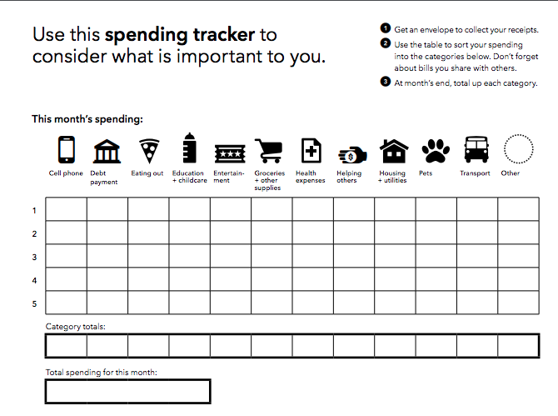
Crunch Your Numbers: Home Buying Costs
How much can you afford?
What amount can you pay monthly?
Look at your spending for the last few months to decide how much you can afford for housing within your monthly expenses. Consider trying the CFPB Spending Tracker to itemize expenses.
What is the right down payment amount for you?
Look at your current savings and investment statements to find your total available funds. Then, consider how much to keep as an emergency fund and for moving costs.
https://s3.amazonaws.com/files.consumerfinance.gov/f/documents/Spending-Tracker_Owning-a-Home_CFPB.pdf
$25,000 - $5,400 - $1,600 = $18,000
Total Saving
Emergency
Funding
Moving
Costs
Amount Available for Down Payment

Slide 12


Crunch Your Numbers: Home Buying Costs
What is your debt-to-income ratio?
Find your debt-to-income ratio
Total Monthly Expenses ÷ Gross Monthly Income (your monthly pay before taxes) = Debt-to-Income Ratio
Example
Total Monthly Expenses
Gross Monthly Income (your monthly pay before taxes)
Debt-to-Income Ratio

Slide 13

Crunch Your Numbers: Home Buying Costs
How much does this all really cost?
Down payment?
Closing costs
Escrow payment
Mortgage: Principal amount of loan, loan interest, property taxes, insurance
Home repairs and maintenance
Possible Additional Expenses:
Private mortgage insurance
Condo fees

Slide 14
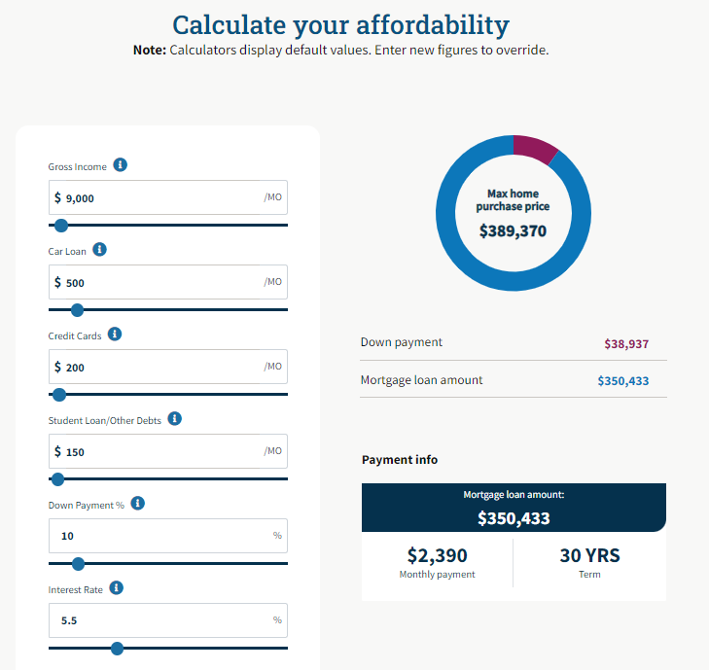
Crunch Your Numbers: Home Buying Costs
Mortgage Affordability Calculator
https://yourhome.fanniemae.com/calculators-tools/mortgage-affordability-calculator

Slide 15
Find Your Match – The Loan Process
Explore and learn about loan options available
Get prepared
Contact potential lenders and get pre-qualified
Choose the kind of loan that works best for your needs (loan term, interest rate, and loan type)
Find the right home
Request and compare loan estimates
Work with your loan officer and loan processor to provide document needed by bank or mortgage company!
Get ready to close!

Slide 16

Find Your Match: The Loan Process
Loan Term: How long you have to repay the loan
Compare your long-term options
Shorter Term
Higher monthly payment
Typically, lower interest rates
Lower total cost
Longer Term
Lower monthly payments
Typically, higher interest rates
Higher total cost

Slide 17
Find Your Match: The Loan Process
Interest Rate Type – Fixed or Adjustable
Compare your interest rate options
Fixed Rate
Lower risk, no surprises
Higher interest rate
Total cost
Rate does not change
Monthly principal and interest payments stay the same
Adjustable Rate
Higher risk, uncertainty
Lower interest rate to start
After initial fixed period, rate can increase or decrease based on the market
Monthly principal and interest payments can increase or decrease over time

Slide 18
Find Your Match: The Loan Process
Loan Type
Each loan type can fit different situations
Conventional loan (not part of a government program): Represents a majority of home loans
Federal Housing Authority (FHA) loan: offer low down payment and are available for lower credit scores
VA loan for active duty, service members, veterans, or surviving spouses
USDA loan for small towns and rural areas
https://www.consumerfinance.gov/owning-a-home/loan-options/

Slide 19
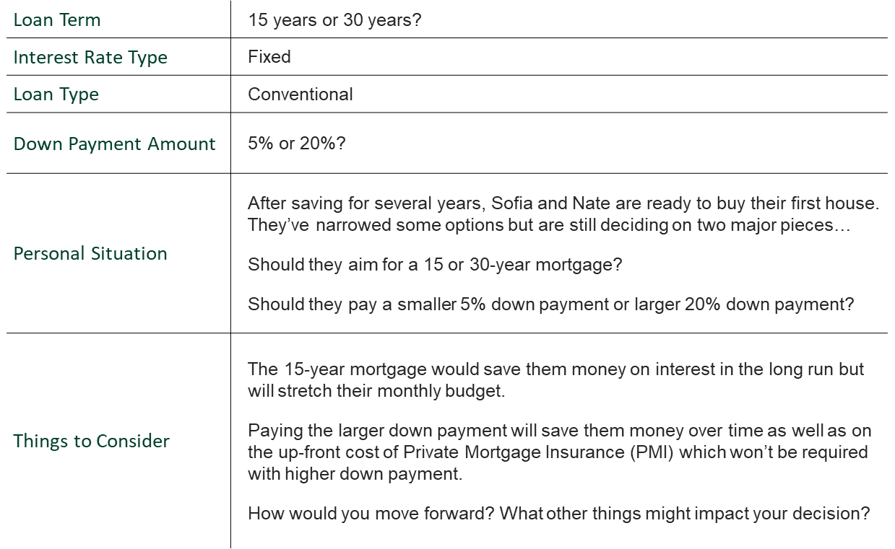
Find Your Match: The Loan Process
Comparing Loan Options

Slide 20
Find Your Match: The Loan Process
Pre-qualification and Loan Shopping
A pre-qualification indicates what amount you may be eligible to borrow
The Benefits of Pre-qualification
Starts a conversation with potential lenders
Supports negotiations as you begin house hunting – showing home sellers you have potential financing
Helps you understand your options and set your budget
What Lenders Consider
Credit score
Debt-to-Income ratio
Down payment available
Employment history

Slide 21
Find Your Match: The Loan Process
Loan Estimates
Loan estimates provide detailed information for the mortgage you request from a lender.
Check out the Consumer Financial Protection Bureau (CFPB) Loan Estimates Explainer to review and compare your loan estimate details.
https://www.consumerfinance.gov/owning-a-home/loan-estimate/

Slide 22
Find Your Match: The Loan Process
Closing Day, time to finish paperwork
and finalize your purchase
Do
Take your time reviewing all documents. This is a 15-30-year commitment!
Prepare ahead of time by reviewing the Closing Checklist handout
Leave the table feeling comfortable with all the details
Don't
Rush over details, stop and confirm that you agree with all terms.
Feel like you should have all the answers. Home buying is a complex process. Ask Questions!
Sign anything you do not feel entirely comfortable with

Slide 23
Preserving Your Home: Quick Tips & Key Considerations
Caring for your Home
Create a plan for home maintenance costs
Budget and save for a 3-6-month emergency fund
Budget for homeowners' insurance to cover the unexpected like fires or burglary

Slide 24

Preserving Your Home: Foreclosure Mitigation
Preventing Foreclosure
Look for solutions early and often. If you find yourself struggling to pay your mortgage, take action as soon as possible. Reach out to your loan servicer or banker.
Consider your options. Can you modify your loan terms to make your monthly mortgage affordable?
Seek foreclosure prevention counseling. Ask for expert help, there are resources available through the CFPB and HUD.
Reach Out for Help
Visit consumerfinance.gov/mortgagehelp or call the CFPB at (855) 411-CFPB(2372) to find a HUD-approved housing counselor.

Slide 25

Thank You and Questions
Resources for Next Steps
Our Learning Center is designed to empower you to discover the best ways to own your own home. Scan the QR below to access tools and tips covering a wide variety of personal finance topics whenever, and wherever, is convenient for you.
https://tdbank.everfi-next.net/
https://www.td.com/us/en/personal-banking/learning/understanding-your-credit https://www.td.com/us/en/personal-banking/mortgage/ https://www.consumerfinance.gov/owning-a-home/ https://www.hud.gov/

Slide 26

Stay in Touch!
Edwin A Restrepo
CMLO
NMLS # 466485
Edwin.restrepo@td.com
413-464-2864

